Slide 1



Predicting Bitcoin Prices
by Afif Salman
Notes:
Hello, everyone. My name is Afif Salman Bin Abdul Ghafar. Today, I will be presenting my project on predicting Bitcoin prices using data science techniques.

Slide 2

Introduction
1
Objective
The objective is to predict Bitcoin prices to assist traders and investors in making informed decisions.
2
Importance
Bitcoin's high volatility presents both opportunities and risks for investors, making accurate predictions valuable.
Notes:
The goal of my project is to predict Bitcoin prices to help traders and investors make better decisions. Bitcoin is known for its high price volatility, which means its value can change rapidly. This creates both opportunities and risks for investors, making accurate predictions valuable.

Slide 3

Time Series Visualization
1
Time Series Visualization
Historical Bitcoin price data was analyzed to understand trends and patterns over time.
2
Insights
This visualization helps illustrate how Bitcoin prices have fluctuated historically, providing insights into market behavior.
Notes:
Here, we see a line plot showing Bitcoin prices over time. This helps us understand how Bitcoin prices have changed historically. Identifying these trends and patterns is crucial for making accurate predictions.

Slide 4
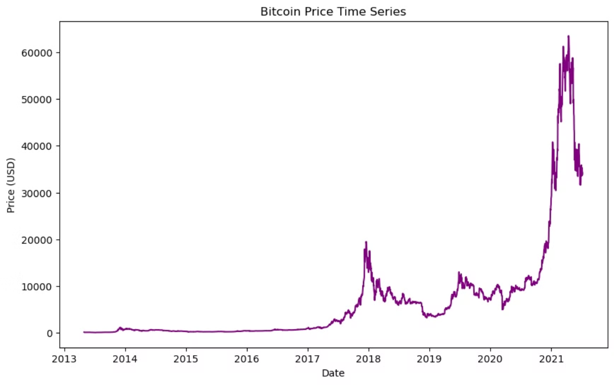
Graph

Slide 5

Distribution Plot
Distribution of Bitcoin Prices
Insights
A histogram was created to show the distribution of Bitcoin prices.
This plot helps understand the frequency and range of Bitcoin price movements, essential for predicting future price trends.
Notes:
This histogram shows the distribution of Bitcoin prices. It tells us how often different price levels occur. Understanding this helps us grasp the range and volatility of Bitcoin prices.

Slide 6
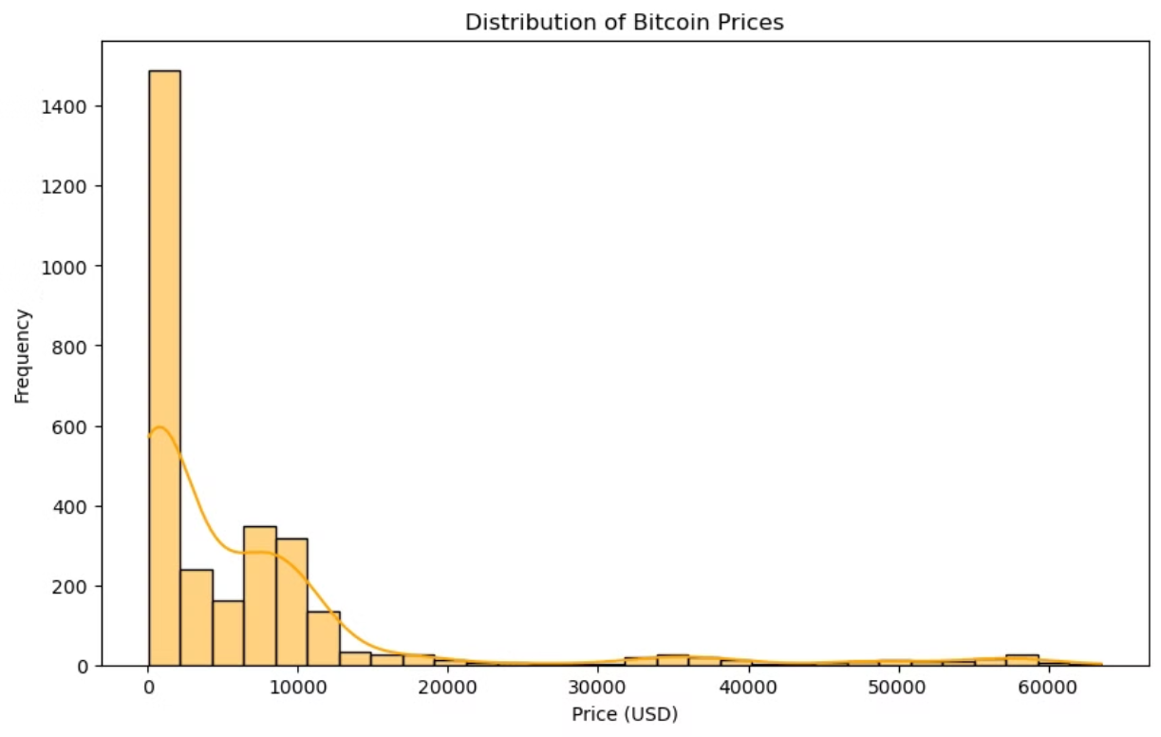
Graph

Slide 7
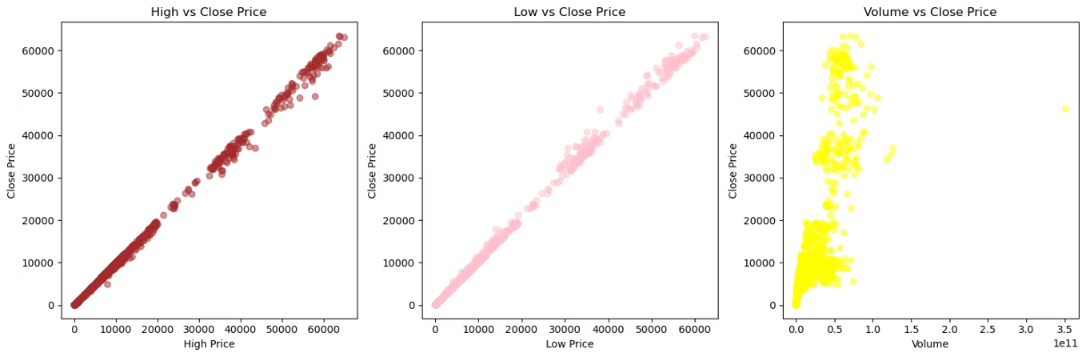
Feature Analysis
Feature Analysis
Insights
Features such as 'High vs Close Price', 'Low vs Close Price', and 'Volume vs Close Price' were analyzed using scatter plots.
These graphs illustrate correlations between different factors and Bitcoin prices, helping to identify influential variables for prediction.
Notes:
These scatter plots show the relationships between Bitcoin's closing prices and other factors like the highest price of the day, the lowest price of the day, and trading volume. By examining these relationships, we can identify which factors are important for predicting Bitcoin prices.

Slide 8



Feature Engineering
Feature Engineering
New features like lagged prices and extracted date components (day, month, year) were engineered.
Benefits
These enhancements improved the model's ability to capture significant trends in Bitcoin price movements.
Notes:
I created new features to improve the prediction model. These include lagged prices (yesterday's and the day before's prices) and breaking down the date into day, month, and year. These new features help the model capture trends and seasonal patterns in Bitcoin prices.

Slide 9

Data Preparation
Data Splitting
The data was split into training and testing sets, allocating 80% for training and 20% for testing.
Standardization
Numerical features were standardized using the StandardScaler to ensure all variables contribute equally to the model.
Notes:
I split the data into two parts: one for training the model (80%) and one for testing it (20%). This helps us see how well the model performs on unseen data. I also standardized the data to ensure all variables contribute equally to the predictions.

Slide 10




Model Training and Evaluation
Model Selection
Model Training
Model Evaluation
Linear Regression was selected as the model for predicting Bitcoin prices due to its simplicity and effectiveness with continuous data.
The Linear Regression model was trained using the scaled training data.
The model's performance was evaluated using metrics such as Mean Squared Error (MSE) and R-squared (R²).
Mean Squared Error (MSE): 48,080.04
Measures the average squared difference between predicted and actual prices. Lower values indicate better accuracy.
R-squared (R²): 0.9996
Indicates how well the model's predictions explain the variation in Bitcoin prices. A value closer to 1 signifies a strong fit.
Notes:
Model Training: I used a Linear Regression model to predict Bitcoin prices. This model finds a relationship between the input features and the price. I trained the model using the prepared training data. Model Evaluation: Here, we compare the actual Bitcoin prices with the predicted prices from our model. The two key metrics we use to evaluate the model are: Mean Squared Error (MSE): Lower values indicate better accuracy. R-squared (R²): Values close to 1 indicate the model fits the data well. Our model has an MSE of 48,080.04 and an R² of 0.9996, showing it predicts Bitcoin prices accurately." Results and Insights Our model's predictions closely match actual Bitcoin prices. This suggests our approach can be useful for traders and investors to make informed decisions based on predicted price trends.

Slide 11
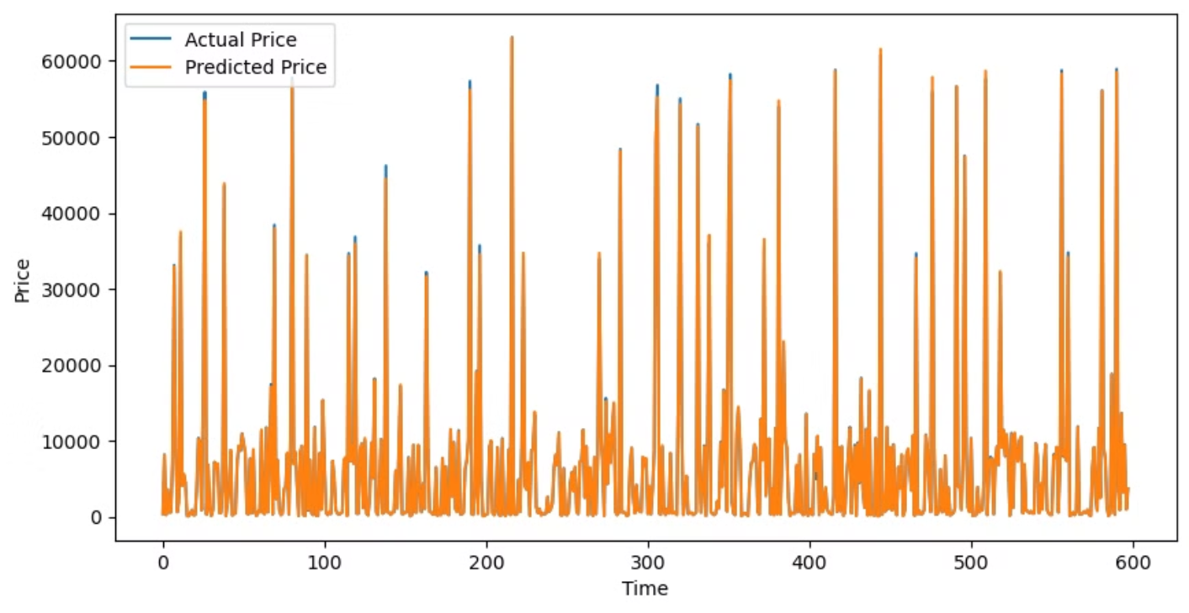
Result

Slide 12

Conclusion
In conclusion, the model successfully predicts Bitcoin prices based on historical data and identified market trends. This approach can help traders and investors make more informed decisions in the volatile cryptocurrency market.
Notes:
In conclusion, my model successfully predicts Bitcoin prices using historical data and identified trends. This approach can help traders and investors navigate the volatile cryptocurrency market with more confidence.

Slide 13
References
Nakamoto, S. (2008). Bitcoin: A peer-to-peer electronic cash system. Retrieved from https://bitcoin.org/bitcoin.pdf
Yermack, D. (2015). Is Bitcoin a real currency? An economic appraisal. Handbook of Digital Currency, 31-43. https://doi.org/10.1016/B978-0-12-802117-0.00002-5
Kristoufek, L. (2015). What are the main drivers of the Bitcoin price? Evidence from wavelet coherence analysis. PLOS ONE, 10(4), e0123923. https://doi.org/10.1371/journal.pone.0123923
Urquhart, A. (2016). The inefficiency of Bitcoin. Economics Letters, 148, 80-82. https://doi.org/10.1016/j.econlet.2016.09.019
Cheah, E.-T., & Fry, J. (2015). Speculative bubbles in Bitcoin markets? An empirical investigation into the fundamental value of Bitcoin. Economics Letters, 130, 32-36. https://doi.org/10.1016/j.econlet.2015.02.029
Notes:
Here are the references I used for my analysis. These sources provided valuable information and data for my project.

Slide 14

Q&A
Thank you for your attention! I welcome any questions or comments you may have. Let's open the floor for discussion.
Notes:
Thank you for your attention! I'm happy to take any questions or comments you may have. Let's open the floor for discussion. Question: What exactly is Bitcoin? Answer: Bitcoin is a digital currency, also known as a cryptocurrency. It was created in 2008 by an anonymous person or group known as Satoshi Nakamoto. Unlike traditional currencies, Bitcoin operates without a central bank and relies on a decentralized network of computers to manage transactions and issue new bitcoins. Question: Why did you choose to predict Bitcoin prices? Answer: Bitcoin is known for its high volatility, meaning its price can change significantly in a short period. Predicting its price can help traders and investors make informed decisions, potentially reducing risks and capitalizing on investment opportunities. Question: What is a Linear Regression model? Answer: A Linear Regression model is a simple statistical method used to understand the relationship between two or more variables. In this case, it helps predict Bitcoin prices based on historical data and other factors by finding the best-fitting line through the data points. Question: How accurate are your predictions? Answer: My model has a Mean Squared Error (MSE) of 48,080.04 and an R-squared (R²) of 0.9996. This means that the predictions are very close to the actual Bitcoin prices, indicating high accuracy. Question: What are some of the factors that influence Bitcoin prices? Answer: Some factors that influence Bitcoin prices include market demand, regulatory news, technological advancements, economic events, and even social media trends. In my analysis, I looked at historical prices, trading volume, and other market data to predict future prices. Question: What are lagged prices, and why are they important? Answer: Lagged prices are previous days' prices. For example, yesterday's and the day before yesterday's prices are lagged prices. They are important because they help capture trends and patterns in price movements, which can be useful for making predictions. Question: Can your model be used for predicting other cryptocurrencies? Answer: Yes, the same approach can be applied to other cryptocurrencies. However, each cryptocurrency may have different influencing factors, so the model might need to be adjusted accordingly. Question: How did you ensure your data was reliable? Answer: I used historical price data from reputable sources and applied data cleaning techniques such as filling in missing values to ensure the data was complete and accurate before using it for analysis and prediction. Question: What are the limitations of your model? Answer: While the model shows high accuracy in predictions, it is based on historical data and may not account for sudden, unforeseen events that can affect Bitcoin prices. Additionally, the model assumes that past trends will continue in the future, which may not always be the case. Question: How can traders and investors use your predictions? Answer: Traders and investors can use the predictions to make more informed decisions about buying or selling Bitcoin. By understanding potential future price movements, they can better manage risks and identify opportunities for profit. Question: What tools and technologies did you use for your analysis? Answer: I used Python programming language and various data science libraries such as pandas for data manipulation, matplotlib and seaborn for visualization, and scikit-learn for model training and evaluation. Question: Can your model predict the exact future price of Bitcoin? Answer: The model provides an estimate based on historical data and trends. While it aims to be as accurate as possible, predicting the exact future price of Bitcoin is challenging due to the market's inherent volatility and unpredictability. Question: What’s next for your project? Answer: Future steps could include improving the model by incorporating more features, experimenting with other types of models, and extending the analysis to other cryptocurrencies or financial assets. Question: How long did it take you to complete this project? Answer: The project took several weeks, including time spent on data collection, preprocessing, model training, evaluation, and visualization. Question: Is this model suitable for real-time predictions? Answer: While the model is based on historical data and provides valuable insights, real-time predictions would require continuous data updates and possibly more complex models to handle real-time market changes.

